Slide 1
Modeling of Attempt-to-Escape Frequency: Tunneling Emission of Trapped Electrons in Tunneling Oxide of 3D NAND Flash Memories -Figures- 20241231 진명

Slide 2
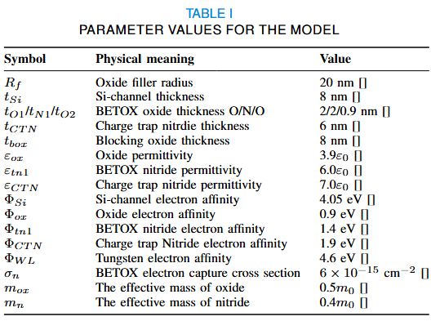
Table 1
각각 값에 대해서는 reference 추가 예정
연구실 소자 스펙과 동일

Slide 3

Figure 2
(a)
(b)
(c)
F_{n, j}
BE-TOX (ONO)
…
Si-Channel
(reservoir)
Trap Region
…
E_{C}
O2 layer
CTN
j^{th} segment
O1 layer
N1 layer
E_{C,r}
Tunneling Emission
(E_{trap} > E_{F,r})
E_{trap}
TC_{n,j}
E_{F,r}
TC_{n,j}
E_{V,r}
E_{V}
Φ_{L}
Φ_{H}
TC_{ox}
1-λ
λ
Tunneling emission model [1]
BETOX detrap emission description
Segment method of electron emission simulation
[1] Jinmenez-Molinos, JAP, 2002

Slide 4
Figure 3
0.6 eV Elastic
0.8 eV Elastic
1.5 eV Elastic
조형준 Endurance 논문에서 등장하는 trap profile적용
Single level & Gaussian profile result
>> PV level / profile comparison 더 효과적으로 하는 방법 고민중

Slide 5

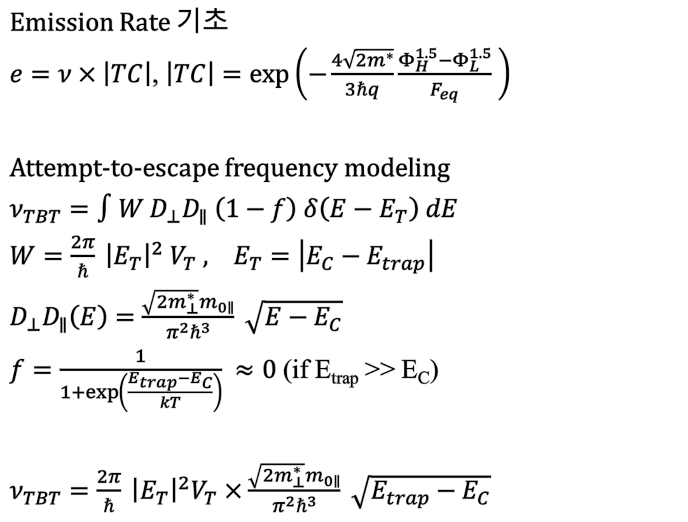
Main Equations
Emission Rate 기초
$e=ν×\left|TC\right|$, $\left|TC\right|=\exp\left(−\frac{4\sqrt{2m^{∗}}}{3ℏq}\frac{Φ_{H}^{1.5}−Φ_{L}^{1.5}}{F_{eq}} \right)$
Attempt-to-escape frequency modeling
$ν_{TBT}=∫W D_{⊥}D_{∥} \left(1−f\right) δ\left(E−E_{T}\right) dE$
$W=\frac{2π}{ℏ} {\left|E_{T}\right|}^{2} V_{T} , E_{T}=\left|E_{C}−E_{trap}\right|$
$D_{⊥}D_{∥}\left(E\right)=\frac{\sqrt{2m_{⊥}^{∗}}m_{0∥}}{π^{2}ℏ^{3}} \sqrt{E−E_{C}}$
$f=\frac{1}{1+\exp\left(\frac{E_{trap}−E_{C}}{kT}\right)} ≈0$ (if E_{trap} >> E_{C})
$ν_{TBT}=\frac{2π}{ℏ} {\left|E_{T}\right|}^{2}V_{T}×\frac{\sqrt{2m_{⊥}^{∗}}m_{0∥}}{π^{2}ℏ^{3}} \sqrt{E_{trap}−E_{C}}$
Electron Emission Simulation
$\frac{dn_{t,j}}{dt}=−e_{TBT}n_{t,j}$
$n_{t}= \sum_{j=1}^{seg}{n_{t,j}}$
$= \sum_{j=1}^{seg}{n_{t0,j}} (1−exp(−e_{TBT,j}t)$
[1] Jinmenez-Molinos, JAP, 2002

